Slide 1

Trees 2
(Trees)
Chris Piech
CS 106B
Lecture 19
Feb 22, 2016
CS 106B
2011

Slide 2

Socrative
Room: 106BWIN16

Slide 3

Today’s Goal
Practice with trees
Pointers by reference
Be able to insert into a tree

Slide 4




Today’s Route
Monday
Trie
Pensive
& Pointers
Review
Tree River

Slide 5

Today’s Route
Monday
Trie
Pensive
& Pointers
Review
Tree River

Slide 6
Binary Tree
struct Tree {
string value;
Tree * left;
Tree * right;
};
value

Slide 7
Tree
struct Tree {
string value;
Vector<Tree *> children;
};
value
…

Slide 8
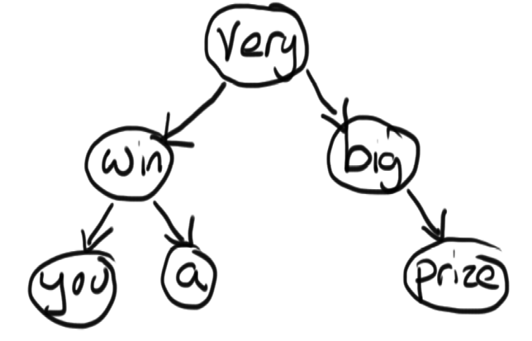
Game Show Tree
void doorOne(Tree * tree) {
if(tree == NULL) return;
cout<<tree->value<<” “;
doorOne(tree->left);
doorOne(tree->right);
}
void doorTwo(Tree * tree) {
if(tree == NULL) return;
doorTwo(tree->left);
cout<<tree->value<<” “;
doorTwo(tree->right);
}
Void doorThree(Tree * tree) {
if(tree == NULL) return;
doorThree(tree->left);
doorThree(tree->right);
cout<<tree->value<<” “;
}

Slide 9
Game Show Tree
void preOrder(Tree * tree) {
if(tree == NULL) return;
cout<<tree->value<<” “;
preOrder(tree->left);
preOrder(tree->right);
}
void inOrder(Tree * tree) {
if(tree == NULL) return;
inOrder(tree->left);
cout<<tree->value<<” “;
inOrder(tree->right);
}
Void postOrder(Tree * tree) {
if(tree == NULL) return;
postOrder(tree->left);
postOrder(tree->right);
cout<<tree->value<<” “;
}

Slide 10
Game Show Tree
void preOrder(Tree * tree) {
if(tree == NULL) return;
cout<<tree->value<<” “;
preOrder(tree->left);
preOrder(tree->right);
}
void inOrder(Tree * tree) {
if(tree == NULL) return;
inOrder(tree->left);
cout<<tree->value<<” “;
inOrder(tree->right);
}
Void postOrder(Tree * tree) {
if(tree == NULL) return;
postOrder(tree->left);
postOrder(tree->right);
cout<<tree->value<<” “;
}

Slide 11
Game Show Tree
void preOrder(Tree * tree) {
if(tree == NULL) return;
cout<<tree->value<<” “;
preOrder(tree->left);
preOrder(tree->right);
}
void inOrder(Tree * tree) {
if(tree == NULL) return;
inOrder(tree->left);
cout<<tree->value<<” “;
inOrder(tree->right);
}
Void postOrder(Tree * tree) {
if(tree == NULL) return;
postOrder(tree->left);
postOrder(tree->right);
cout<<tree->value<<” “;
}
Root goes before
children
1

Slide 12
Game Show Tree
void preOrder(Tree * tree) {
if(tree == NULL) return;
cout<<tree->value<<” “;
preOrder(tree->left);
preOrder(tree->right);
}
void inOrder(Tree * tree) {
if(tree == NULL) return;
inOrder(tree->left);
cout<<tree->value<<” “;
inOrder(tree->right);
}
Void postOrder(Tree * tree) {
if(tree == NULL) return;
postOrder(tree->left);
postOrder(tree->right);
cout<<tree->value<<” “;
}
Root goes before
children
1
2
3

Slide 13
Game Show Tree
void preOrder(Tree * tree) {
if(tree == NULL) return;
cout<<tree->value<<” “;
preOrder(tree->left);
preOrder(tree->right);
}
void inOrder(Tree * tree) {
if(tree == NULL) return;
inOrder(tree->left);
cout<<tree->value<<” “;
inOrder(tree->right);
}
Void postOrder(Tree * tree) {
if(tree == NULL) return;
postOrder(tree->left);
postOrder(tree->right);
cout<<tree->value<<” “;
}

Slide 14
Game Show Tree
void preOrder(Tree * tree) {
if(tree == NULL) return;
cout<<tree->value<<” “;
preOrder(tree->left);
preOrder(tree->right);
}
void inOrder(Tree * tree) {
if(tree == NULL) return;
inOrder(tree->left);
cout<<tree->value<<” “;
inOrder(tree->right);
}
Void postOrder(Tree * tree) {
if(tree == NULL) return;
postOrder(tree->left);
postOrder(tree->right);
cout<<tree->value<<” “;
}

Slide 15
Game Show Tree
void preOrder(Tree * tree) {
if(tree == NULL) return;
cout<<tree->value<<” “;
preOrder(tree->left);
preOrder(tree->right);
}
void inOrder(Tree * tree) {
if(tree == NULL) return;
inOrder(tree->left);
cout<<tree->value<<” “;
inOrder(tree->right);
}
Void postOrder(Tree * tree) {
if(tree == NULL) return;
postOrder(tree->left);
postOrder(tree->right);
cout<<tree->value<<” “;
}
Left, Root, Right
1

Slide 16
Game Show Tree
void preOrder(Tree * tree) {
if(tree == NULL) return;
cout<<tree->value<<” “;
preOrder(tree->left);
preOrder(tree->right);
}
void inOrder(Tree * tree) {
if(tree == NULL) return;
inOrder(tree->left);
cout<<tree->value<<” “;
inOrder(tree->right);
}
Void postOrder(Tree * tree) {
if(tree == NULL) return;
postOrder(tree->left);
postOrder(tree->right);
cout<<tree->value<<” “;
}
Left, Root, Right
2
1
3

Slide 17
Game Show Tree
void preOrder(Tree * tree) {
if(tree == NULL) return;
cout<<tree->value<<” “;
preOrder(tree->left);
preOrder(tree->right);
}
void inOrder(Tree * tree) {
if(tree == NULL) return;
inOrder(tree->left);
cout<<tree->value<<” “;
inOrder(tree->right);
}
void postOrder(Tree * tree) {
if(tree == NULL) return;
postOrder(tree->left);
postOrder(tree->right);
cout<<tree->value<<” “;
}

Slide 18
Game Show Tree
void preOrder(Tree * tree) {
if(tree == NULL) return;
cout<<tree->value<<” “;
preOrder(tree->left);
preOrder(tree->right);
}
void inOrder(Tree * tree) {
if(tree == NULL) return;
inOrder(tree->left);
cout<<tree->value<<” “;
inOrder(tree->right);
}
void postOrder(Tree * tree) {
if(tree == NULL) return;
postOrder(tree->left);
postOrder(tree->right);
cout<<tree->value<<” “;
}

Slide 19
Game Show Tree
void preOrder(Tree * tree) {
if(tree == NULL) return;
cout<<tree->value<<” “;
preOrder(tree->left);
preOrder(tree->right);
}
void inOrder(Tree * tree) {
if(tree == NULL) return;
inOrder(tree->left);
cout<<tree->value<<” “;
inOrder(tree->right);
}
void postOrder(Tree * tree) {
if(tree == NULL) return;
postOrder(tree->left);
postOrder(tree->right);
cout<<tree->value<<” “;
}
Children go before
root
1

Slide 20
Game Show Tree
void preOrder(Tree * tree) {
if(tree == NULL) return;
cout<<tree->value<<” “;
preOrder(tree->left);
preOrder(tree->right);
}
void inOrder(Tree * tree) {
if(tree == NULL) return;
inOrder(tree->left);
cout<<tree->value<<” “;
inOrder(tree->right);
}
void postOrder(Tree * tree) {
if(tree == NULL) return;
postOrder(tree->left);
postOrder(tree->right);
cout<<tree->value<<” “;
}
Children go before
root
1
2

Slide 21
Game Show Tree
void preOrder(Tree * tree) {
if(tree == NULL) return;
cout<<tree->value<<” “;
preOrder(tree->left);
preOrder(tree->right);
}
void inOrder(Tree * tree) {
if(tree == NULL) return;
inOrder(tree->left);
cout<<tree->value<<” “;
inOrder(tree->right);
}
void postOrder(Tree * tree) {
if(tree == NULL) return;
postOrder(tree->left);
postOrder(tree->right);
cout<<tree->value<<” “;
}
Children go before
root
3
1
2

Slide 23
Free Tree
void preOrder(Tree * tree) {
if(tree == NULL) return;
delete tree;
preOrder(tree->left);
preOrder(tree->right);
}
void inOrder(Tree * tree) {
if(tree == NULL) return;
inOrder(tree->left);
delete tree;
inOrder(tree->right);
}
void postOrder(Tree * tree) {
if(tree == NULL) return;
postOrder(tree->left);
postOrder(tree->right);
delete tree
}
preOrder
inOrder
postOrder

Slide 24
Today’s Route
Monday
Trie
Pensive
& Pointers
Review
Tree River

Slide 25
You can achieve pass by reference using pointers

Slide 26
Pass by Pointer
void mystery(Point * p1) {
p1->x = 5;
}
int main() {
Point * point = new Point;
point->x = 10;
mystery(point);
cout << point->x << endl;
}

Slide 27
Pass by Pointer
void mystery(Point * p1) {
p1->x = 5;
}
int main() {
Point * point = new Point;
point->x = 10;
mystery(point);
cout << point->x << endl;
}
a) 5
b) 10
c) random
d) crash

Slide 28
Pass by Pointer
void mystery(Point * p1) {
p1->x = 5;
}
int main() {
Point * point = new Point;
point->x = 10;
mystery(point);
cout << point->x << endl;
}
Stack
Heap
main

Slide 29
Pass by Pointer
void mystery(Point * p1) {
p1->x = 5;
}
int main() {
Point * point = new Point;
point->x = 10;
mystery(point);
cout << point->x << endl;
}
Stack
Heap
main
0x1234
x
point
0x1234
y

Slide 30
Pass by Pointer
void mystery(Point * p1) {
p1->x = 5;
}
int main() {
Point * point = new Point;
point->x = 10;
mystery(point);
cout << point->x << endl;
}
Stack
Heap
main
0x1234
x
10
point
0x1234
y

Slide 31
Pass by Pointer
void mystery(Point * p1) {
p1->x = 5;
}
int main() {
Point * point = new Point;
point->x = 10;
mystery(point);
cout << point->x << endl;
}
Stack
Heap
main
mystery
0x1234
x
10
point
p1
0x1234
0x1234
y

Slide 32
Pass by Pointer
void mystery(Point * p1) {
p1->x = 5;
}
int main() {
Point * point = new Point;
point->x = 10;
mystery(point);
cout << point->x << endl;
}
Stack
Heap
main
mystery
0x1234
x
5
point
p1
0x1234
0x1234
y

Slide 33
Pass by Pointer
void mystery(Point * p1) {
p1->x = 5;
}
int main() {
Point * point = new Point;
point->x = 10;
mystery(point);
cout << point->x << endl;
}
Stack
Heap
main
0x1234
x
5
point
0x1234
y

Slide 34
Pass by Pointer
void mystery(Point * p1) {
p1->x = 5;
}
int main() {
Point * point = new Point;
point->x = 10;
mystery(point);
cout << point->x << endl;
}
Stack
Heap
main
0x1234
x
5
point
0x1234
y

Slide 35
What does this do?

Slide 36
Pass by Pointer
void mystery(Point * p1) {
p1 = new Point;
p1->x = 5;
}
int main() {
Point * point = NULL;
mystery(point);
cout << point->x << endl;
}

Slide 37
Pass by Pointer
void mystery(Point * p1) {
p1 = new Point;
p1->x = 5;
}
int main() {
Point * point = NULL;
mystery(point);
cout << point->x << endl;
}
Stack
Heap
main

Slide 38
Pass by Pointer
void mystery(Point * p1) {
p1 = new Point;
p1->x = 5;
}
int main() {
Point * point = NULL;
mystery(point);
cout << point->x << endl;
}
Stack
Heap
main
point
NULL

Slide 39
Pass by Pointer
void mystery(Point * p1) {
p1 = new Point;
p1->x = 5;
}
int main() {
Point * point = NULL;
mystery(point);
cout << point->x << endl;
}
Stack
Heap
main
point
NULL

Slide 40
Pass by Pointer
void mystery(Point * p1) {
p1 = new Point;
p1->x = 5;
}
int main() {
Point * point = NULL;
mystery(point);
cout << point->x << endl;
}
Stack
Heap
main
mystery
point
p1
NULL
NULL

Slide 41
Pass by Pointer
void mystery(Point * p1) {
p1 = new Point;
p1->x = 5;
}
int main() {
Point * point = NULL;
mystery(point);
cout << point->x << endl;
}
Stack
Heap
main
mystery
0x1234
x
point
p1
NULL
0x1234
y

Slide 42
Pass by Pointer
void mystery(Point * p1) {
p1 = new Point;
p1->x = 5;
}
int main() {
Point * point = NULL;
mystery(point);
cout << point->x << endl;
}
Stack
Heap
main
mystery
0x1234
x
5
point
p1
NULL
0x1234
y

Slide 43
Pass by Pointer
void mystery(Point * p1) {
p1 = new Point;
p1->x = 5;
}
int main() {
Point * point = NULL;
mystery(point);
cout << point->x << endl;
}
Stack
Heap
main
0x1234
x
5
point
NULL
y

Slide 44

Pass by Pointer
void mystery(Point * p1) {
p1 = new Point;
p1->x = 5;
}
int main() {
Point * point = NULL;
mystery(point);
cout << point->x << endl;
}
Stack
Heap
main
0x1234
x
5
point
NULL
y

Slide 45
What went wrong?

Slide 46
Pass by Pointer
void mystery(Point * p1) {
p1 = new Point;
p1->x = 5;
}
int main() {
Point * point = NULL;
mystery(point);
cout << point->x << endl;
}

Slide 47
How about now?

Slide 48
Pointer by Reference
void mystery(Point * & p1) {
p1 = new Point;
p1->x = 5;
}
int main() {
Point * point = NULL;
mystery(point);
cout << point->x << endl;
}

Slide 49
Pointer by Reference
void mystery(Point * & p1) {
p1 = new Point;
p1->x = 5;
}
int main() {
Point * point = NULL;
mystery(point);
cout << point->x << endl;
}
Stack
Heap
main

Slide 50
Pointer by Reference
void mystery(Point * & p1) {
p1 = new Point;
p1->x = 5;
}
int main() {
Point * point = NULL;
mystery(point);
cout << point->x << endl;
}
Stack
Heap
main
point
NULL

Slide 51
Pointer by Reference
void mystery(Point * & p1) {
p1 = new Point;
p1->x = 5;
}
int main() {
Point * point = NULL;
mystery(point);
cout << point->x << endl;
}
Stack
Heap
main
point
NULL

Slide 52
Pointer by Reference
void mystery(Point * & p1) {
p1 = new Point;
p1->x = 5;
}
int main() {
Point * point = NULL;
mystery(point);
cout << point->x << endl;
}
Stack
Heap
main
mystery
point
p1
NULL

Slide 53
Pointer by Reference
void mystery(Point * & p1) {
p1 = new Point;
p1->x = 5;
}
int main() {
Point * point = NULL;
mystery(point);
cout << point->x << endl;
}
Stack
Heap
main
mystery
0x1234
x
point
p1
0x1234
y

Slide 54
Pointer by Reference
void mystery(Point * & p1) {
p1 = new Point;
p1->x = 5;
}
int main() {
Point * point = NULL;
mystery(point);
cout << point->x << endl;
}
Stack
Heap
main
mystery
0x1234
x
5
point
p1
0x1234
y

Slide 55
Pointer by Reference
void mystery(Point * & p1) {
p1 = new Point;
p1->x = 5;
}
int main() {
Point * point = NULL;
mystery(point);
cout << point->x << endl;
}
Stack
Heap
main
0x1234
x
5
point
0x1234
y

Slide 56
Pointer by Reference
void mystery(Point * & p1) {
p1 = new Point;
p1->x = 5;
}
int main() {
Point * point = NULL;
mystery(point);
cout << point->x << endl;
}
Stack
Heap
main
0x1234
x
5
point
0x1234
y

Slide 57
Add Random Leaf

Slide 58
Add Random Leaf
S
X
M

Slide 59
Add Random Leaf
S
X
M
G

Slide 60
Add Random Leaf
void addRandomLeaf(Tree * tree) {
if(tree == NULL) {
tree = new Tree;
tree->value = randomChar();
return;
}
if(randomBool()) {
addRandomLeaf(tree->left);
} else {
addRandomLeaf(tree->right);
}
}

Slide 61
Add Random Leaf
0x1234
void addRandomLeaf(Tree * tree) {
if(tree == NULL) {
tree = new Tree;
tree->value = randomChar();
return;
}
if(randomBool()) {
addRandomLeaf(tree->left);
} else {
addRandomLeaf(tree->right);
}
}
S
0x3464
0x7531
X
M
main
root
0x1234

Slide 62
Add Random Leaf
0x1234
void addRandomLeaf(Tree * tree) {
if(tree == NULL) {
tree = new Tree;
tree->value = randomChar();
return;
}
if(randomBool()) {
addRandomLeaf(tree->left);
} else {
addRandomLeaf(tree->right);
}
}
S
0x3464
0x7531
X
M
main
addRandLeaf
root
tree
0x1234
0x1234

Slide 63
Add Random Leaf
0x1234
void addRandomLeaf(Tree * tree) {
if(tree == NULL) {
tree = new Tree;
tree->value = randomChar();
return;
}
if(randomBool()) {
addRandomLeaf(tree->left);
} else {
addRandomLeaf(tree->right);
}
}
S
0x3464
0x7531
X
M
main
addRandLeaf
addRandLeaf
root
tree
tree
0x1234
0x1234
0x3464

Slide 64
Add Random Leaf
0x1234
void addRandomLeaf(Tree * tree) {
if(tree == NULL) {
tree = new Tree;
tree->value = randomChar();
return;
}
if(randomBool()) {
addRandomLeaf(tree->left);
} else {
addRandomLeaf(tree->right);
}
}
S
0x3464
0x7531
X
M
main
addRandLeaf
addRandLeaf
addRandLeaf
root
tree
tree
tree
0x1234
0x1234
0x3464
NULL

Slide 65
Add Random Leaf
0x1234
void addRandomLeaf(Tree * tree) {
if(tree == NULL) {
tree = new Tree;
tree->value = randomChar();
return;
}
if(randomBool()) {
addRandomLeaf(tree->left);
} else {
addRandomLeaf(tree->right);
}
}
S
0x3464
0x7531
X
M
main
addRandLeaf
addRandLeaf
addRandLeaf
root
tree
tree
tree
0x1234
0x1234
0x3464
NULL

Slide 66
Add Random Leaf
0x1234
void addRandomLeaf(Tree * tree) {
if(tree == NULL) {
tree = new Tree;
tree->value = randomChar();
return;
}
if(randomBool()) {
addRandomLeaf(tree->left);
} else {
addRandomLeaf(tree->right);
}
}
S
0x3464
0x7531
X
M
G
main
addRandLeaf
addRandLeaf
addRandLeaf
root
tree
tree
tree
0x1234
0x1234
0x3464
0x9012
0x9012

Slide 67
Add Random Leaf
0x1234
void addRandomLeaf(Tree * tree) {
if(tree == NULL) {
tree = new Tree;
tree->value = randomChar();
return;
}
if(randomBool()) {
addRandomLeaf(tree->left);
} else {
addRandomLeaf(tree->right);
}
}
S
0x3464
0x7531
X
M
G
main
addRandLeaf
addRandLeaf
root
tree
tree
0x1234
0x1234
0x3464
0x9012

Slide 68
Add Random Leaf
0x1234
void addRandomLeaf(Tree * tree) {
if(tree == NULL) {
tree = new Tree;
tree->value = randomChar();
return;
}
if(randomBool()) {
addRandomLeaf(tree->left);
} else {
addRandomLeaf(tree->right);
}
}
S
0x3464
0x7531
X
M
G
main
root
0x1234
0x9012

Slide 69
Add Random Leaf
void addRandomLeaf(Tree * & tree) {
if(tree == NULL) {
tree = new Tree;
tree->value = randomChar();
return;
}
if(randomBool()) {
addRandomLeaf(tree->left);
} else {
addRandomLeaf(tree->right);
}
}

Slide 70
Add Random Leaf
0x1234
void addRandomLeaf(Tree * & tree) {
if(tree == NULL) {
tree = new Tree;
tree->value = randomChar();
return;
}
if(randomBool()) {
addRandomLeaf(tree->left);
} else {
addRandomLeaf(tree->right);
}
}
S
0x3464
0x7531
X
M
main
root
0x1234

Slide 71
Add Random Leaf
0x1234
void addRandomLeaf(Tree * & tree) {
if(tree == NULL) {
tree = new Tree;
tree->value = randomChar();
return;
}
if(randomBool()) {
addRandomLeaf(tree->left);
} else {
addRandomLeaf(tree->right);
}
}
S
0x3464
0x7531
X
M
main
addRandLeaf
root
tree
0x1234
main.root

Slide 72
Add Random Leaf
0x1234
void addRandomLeaf(Tree * & tree) {
if(tree == NULL) {
tree = new Tree;
tree->value = randomChar();
return;
}
if(randomBool()) {
addRandomLeaf(tree->left);
} else {
addRandomLeaf(tree->right);
}
}
S
0x3464
0x7531
X
M
main
addRandLeaf
addRandLeaf
tree
root
tree
0x1234
main.root
main.root->left

Slide 73
Add Random Leaf
0x1234
void addRandomLeaf(Tree * & tree) {
if(tree == NULL) {
tree = new Tree;
tree->value = randomChar();
return;
}
if(randomBool()) {
addRandomLeaf(tree->left);
} else {
addRandomLeaf(tree->right);
}
}
S
0x3464
0x7531
X
M
main
addRandLeaf
addRandLeaf
tree
root
tree
0x1234
main.root
main.root->left->right

Slide 74
Add Random Leaf
0x1234
void addRandomLeaf(Tree * & tree) {
if(tree == NULL) {
tree = new Tree;
tree->value = randomChar();
return;
}
if(randomBool()) {
addRandomLeaf(tree->left);
} else {
addRandomLeaf(tree->right);
}
}
S
0x3464
0x7531
X
M
main
addRandLeaf
addRandLeaf
tree
root
tree
0x1234
main.root
main.root->left->right

Slide 75
Add Random Leaf
0x1234
void addRandomLeaf(Tree * & tree) {
if(tree == NULL) {
tree = new Tree;
tree->value = randomChar();
return;
}
if(randomBool()) {
addRandomLeaf(tree->left);
} else {
addRandomLeaf(tree->right);
}
}
S
0x3464
0x7531
X
M
G
main
addRandLeaf
addRandLeaf
tree
root
tree
0x1234
main.root
main.root->left->right
0x9012

Slide 76
Add Random Leaf
0x1234
void addRandomLeaf(Tree * & tree) {
if(tree == NULL) {
tree = new Tree;
tree->value = randomChar();
return;
}
if(randomBool()) {
addRandomLeaf(tree->left);
} else {
addRandomLeaf(tree->right);
}
}
S
0x3464
0x7531
X
M
G
main
root
0x1234
0x9012

Slide 77
Today’s Route
Monday
Trie
Pensive
& Pointers
Review
Tree River

Slide 78
Today’s Route
Monday
Trie
Pensive
& Pointers
Review
Tree River

Slide 79
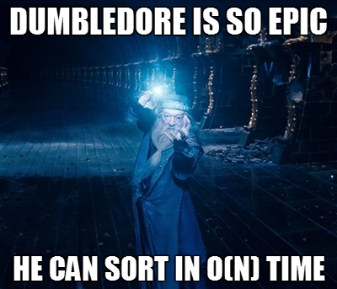

Slide 80
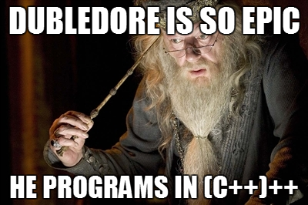

Slide 81
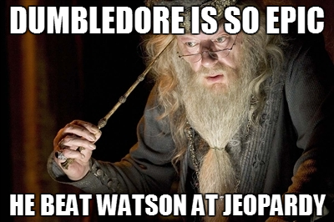

Slide 82


Slide 83
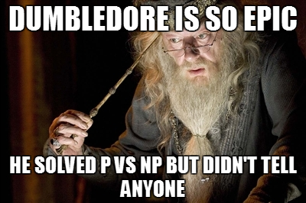

Slide 84
How come Dumbledore knows everything?

Slide 85

Pensive

Slide 86

Pensive Demo

Slide 87
Pensive
Fruit?
no
yes
DJ Khaled?
Banana?

Slide 88
Pensive
Fruit?
no
yes
Banana?
Singer?
no
yes
DJ Khaled?
Beyonce?

Slide 89
Slowly!

Slide 90
Pensive
Fruit?
no
yes
DJ Khaled?
Banana?

Slide 91


Slide 92
Pensive
Fruit?
no
yes
DJ Khaled?
Banana?

Slide 93
Pensive
Fruit?
no
yes
DJ Khaled?
Banana?
Beyonce?

Slide 94
Pensive
Fruit?
no
yes
DJ Khaled?
Banana?
Singer?
Beyonce?

Slide 95
Pensive
Fruit?
no
yes
DJ Khaled?
Banana?
no
Singer?
yes
Beyonce?

Slide 96
Pensive
Fruit?
no
yes
DJ Khaled?
Banana?
no
Singer?
yes
Beyonce?

Slide 97
Pensive
Fruit?
no
yes
Banana?
Singer?
no
yes
DJ Khaled?
Beyonce?

Slide 98
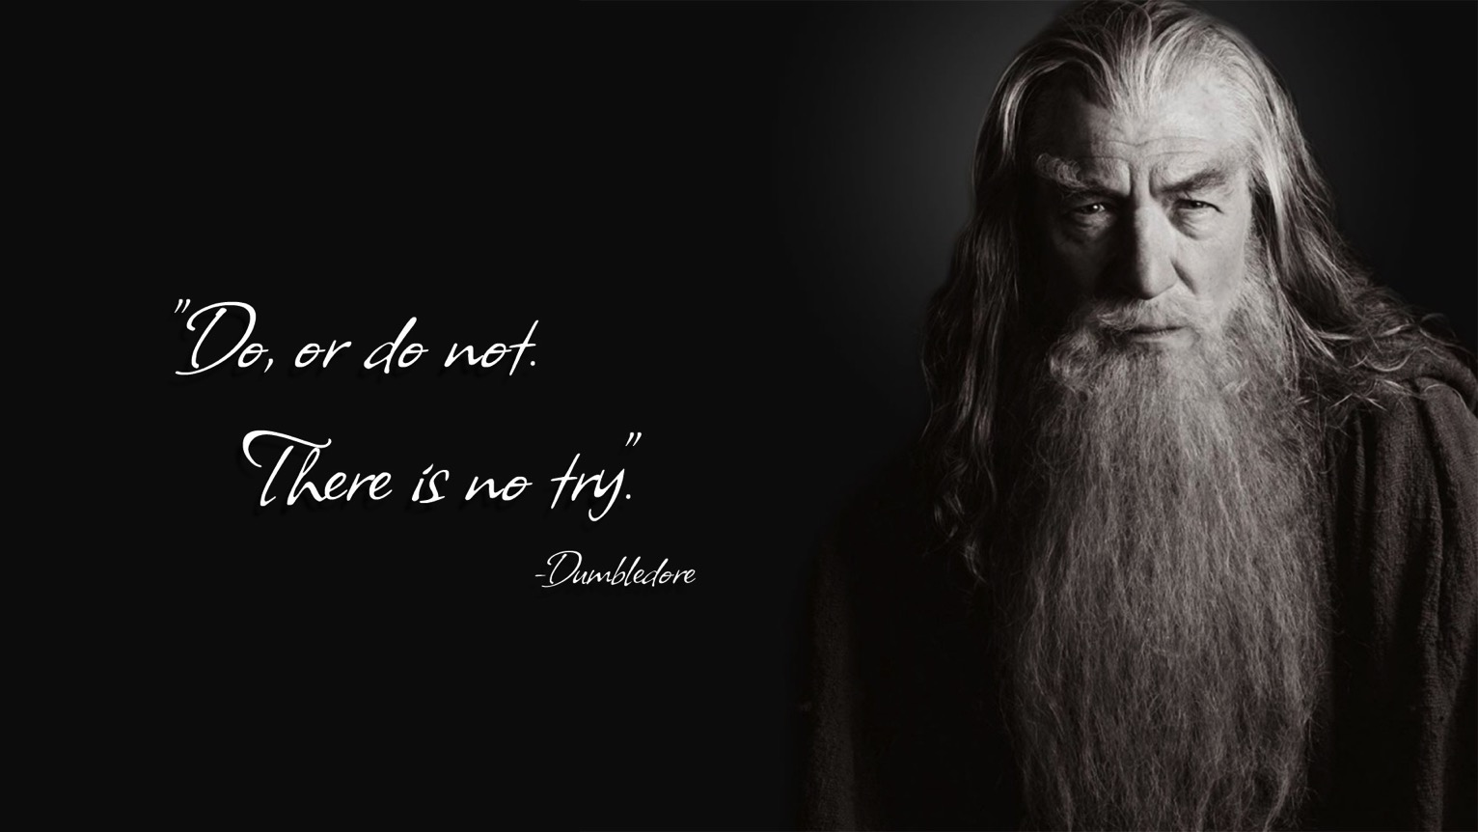

* actually Yoda. But what ever

Slide 99
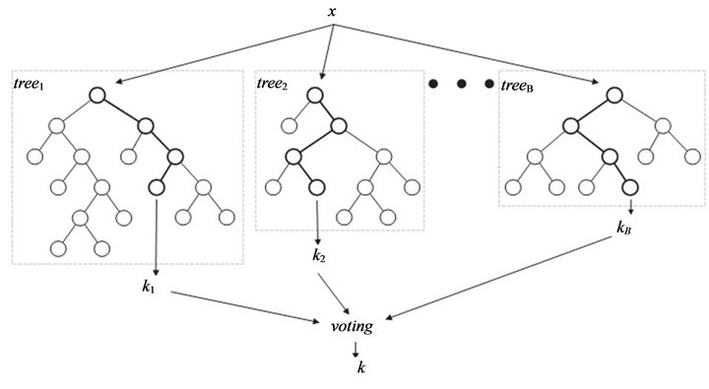
Random Forest

Slide 100
Today’s Route
Monday
Trie
Pensive
& Pointers
Review
Tree River

Slide 101
Today’s Route
Monday
Trie
Pensive
& Pointers
Review
Tree River

Slide 102
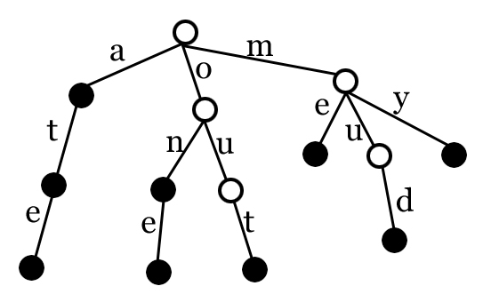
Trie (prefix tree)
trie ("try"): A tree structure optimized for "prefix" searches
e.g. Do any words in the set begin with the prefix "chr"?
This is how the Stanford Lexicon class is implemented

Slide 103
Trie
The idea: instead of a binary tree, use a "26-ary" tree
each node has 26 children for A-Z
add words to the trie by walking down the appropriate child pointer (e.g. "ATE"  A, T, E)
struct TrieNode {
bool word;
TrieNode* children[26];
}

Slide 104
Trie with data
After adding "am", "ate", "me", "mud", "my", "one", "out":
(NULL children omitted)
0 | 12 | 14
a | m | o
""
"a"
12 | 19
m | t
4 | 20 | 24
e | u | y
13 | 20
n | u
...
.
4
e
...
.
3
d
4
e
19
t
"am"
word=true
"at"
"me"
word = true
"mu"
"my"
word = true
"on”
word=true
"ou"
...
.
.
...
.
...
.
...
.
"ate"
word = true
"mud"
word = true
"one"
word = true
"out"
word = true

Slide 105
Today’s Route
Monday
Trie
Pensive
& Pointers
Review
Tree River

Slide 106
Today’s Route
Monday
Trie
Pensive
& Pointers
Review
Tree River

Slide 107

Today’s Goal
Practice with trees
Pointers by reference
Be able to insert into a tree

